Slide 1
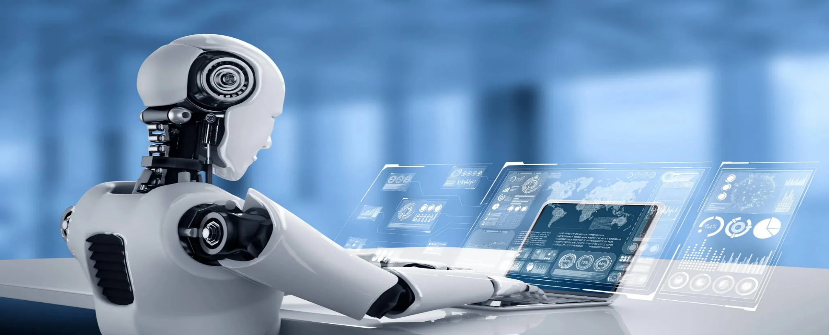
Introduction to Artificial Intelligent
Chapter 1 Introduction
Artificial Intelligence, A Modern Approach
Third Edition
Stuart J. Russell and Peter Norvig
Dr. Samriddhi Sarkar
Asst Prof Sr Gr, SCOPE

Slide 2
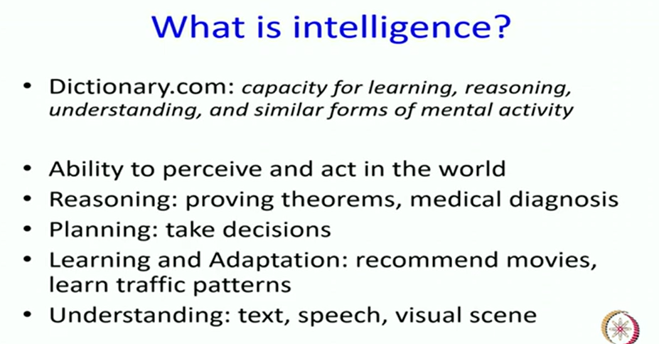
Dictionary meaning of Intelligence

Slide 3
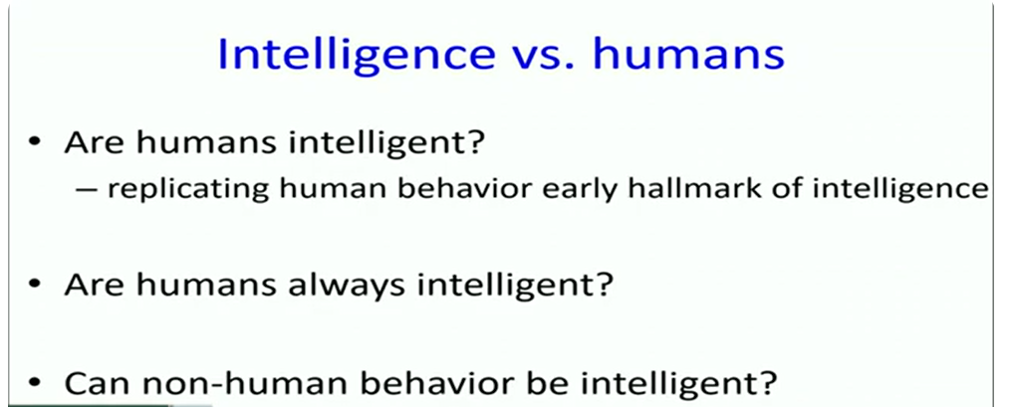
What is intelligence?

Slide 4

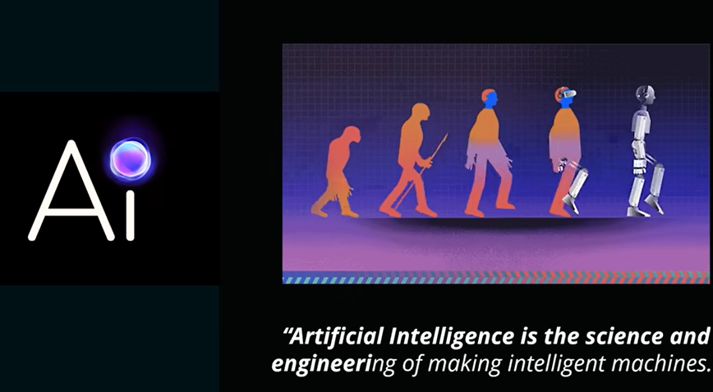
AI is a technique of getting the machines to
work and behave like a human

Slide 5
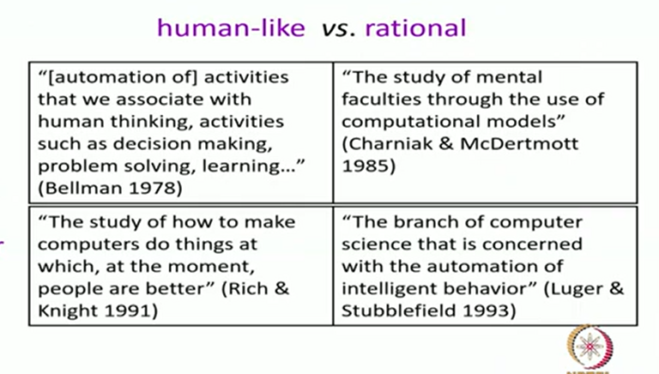
Various Definitions of AI Cont…

Slide 6
Various Definitions of AI Cont…
AI is the study of mental faculties through the use of computational models
-Charniak McDermott, 1985
AI is the art of creating machines that perform functions that require intelligence when performed by people
-Kurzwell, 1990
AI is the study of how to make computers do things at which, at the moment, people are better
-Rich and Knight, 1991

Slide 7
Various Definitions of AI Cont…
AI is the study of the combinations that make it possible to perceive, reason and act
-Winston, 1992
Computational intelligence is the study of the design of intelligent agents
-Poole et al., 1998
AI… is concerned with intelligent behavior in artifacts
-Nilsson, 1998

Slide 8
Various Definitions of AI
AI is the automation of activities that we associate with human thinking, activities such as decision making, problem solving, learning… …
-Bellman, 1978
AI is concerned with designing intelligent computer systems which exhibit the characteristics we associate with intelligence in human behaviour
-Barr and Feignenbaum, 1981
AI is the exciting new effort to make computers think… … machines with minds, in the full and literal sense
- Haugeland, 1985

Slide 9
Definition
AI is a branch of computer science, aim on building machines and software with intelligence similar to humans so that they can perform similar thinking, reasoning, decision-making, problem solving and natural language processing like human.

Slide 10
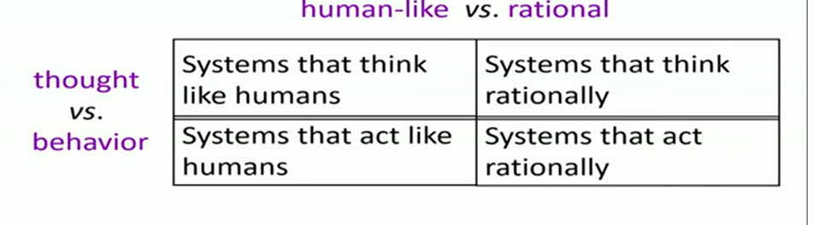
Categories of AI

Slide 11
What is AI?
Views of AI fall into four categories:
Thinking humanly | Thinking rationally
Acting humanly | Acting rationally

Slide 12
What is AI?
Four Categories of Systemic Definitions
Think like humans 3. Think rationally
Act like humans 4. Act rationally
Thinking Like Humans
Machines with minds (Haugeland, 1985)
Automation of “decision making, problem solving, learning…” (Bellman, 1978)
Acting Like Humans
Functions that require intelligence when performed by people (Kurzweil, 1990)
Making computers do things people currently do better (Rich & Knight, 1991)
Thinking Rationally
Computational models of mental faculties (Charniak & McDermott, 1985)
Computations that make it possible to perceive, reason, and act (Winston,
1992)
Acting Rationally
Explaining, emulating int. behavior via computation (Schalkoff, 1990)
Branch of CS: automating intelligent behavior (Luger, 2005)

Slide 13
Thinking humanly: The cognitive modeling approach
If you say that a given program thinks like a human, we must have some way of determining how humans think. The actual workings of human minds can be understood in the following ways:
through introspection—trying to catch our own thoughts as they go by;
through psychological experiments—observing a person in action; and
through brain imaging—observing the brain in action.
Once we have a sufficiently precise theory of the mind, it becomes possible to express the theory as a computer program. E.g.,
HOWEVER, for AI, thinking like a human may not be the ideal case!!

Slide 14
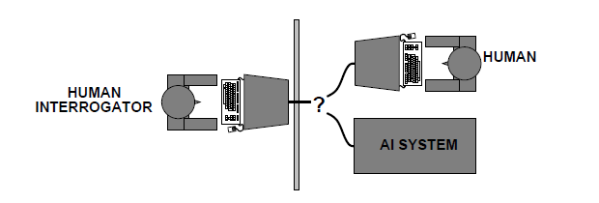
Acting humanly: The Turing Test approach
A computer passes the test if a human interrogator, after asking some written
questions, cannot tell whether the written responses come from a person
or from a computer.
The computer would need to possess the following capabilities:
natural language processing to enable it to communicate successfully in English
knowledge representation to store what it knows or hears;
automated reasoning to use the stored information to answer questions and to draw new conclusions;
machine learning to adapt to new circumstances and to detect and extrapolate patterns
computer vision to perceive objects, and
robotics to manipulate objects and move about.
***the last two capabilities are required to check the perceptual abilities of the machine. Perceptual? all about perceiving, or sensing things. It allows you to make sense of the world around you by seeing and hearing

Slide 15
Thinking rationally: The “laws of thought” approach
Thinking should be purposeful, directed towards the goal.
Not every time one needs to think rationally but (s)he should perform sometimes which is called reflex
Eg. While crossing the road, If I see a truck coming…………….

Slide 16
Acting rationally: The rational agent approach
An agent is just something that acts.
All computer programs do something, but computer agents are expected to do more: operate autonomously, perceive their environment, persist over a prolonged time period, adapt to change, and create and pursue goals.
A rational agent is one that acts so as to achieve the best outcome or, when there is uncertainty, the best expected outcome.
Making correct inferences is sometimes part of being a rational agent

Slide 17
Study of AI involves the development of algorithms and computer programs that can perform tasks that typically require human intelligence such as visual perception, speech recognition, decision-making, and language translation
AI has the potential to revolutionize many industries and has a wide range of applications, from virtual personal assistants to self-driving cars
Intelligence: The ability to learn and solve problems.
Intelligence, as we know, is the ability to acquire and apply knowledge.
Knowledge is the information acquired through experience.
Experience is the knowledge gained through exposure(training).

Slide 18
Intelligence is composed of:
Reasoning: The process of thinking about something in a logical way in order to form a conclusion or judgement
Learning: Knowledge/Experience that you get from studying/working.
Problem-Solving: Act of defining a problem; determining the cause of the problem; identifying, prioritizing, and selecting alternatives for a solution; and implementing a solution
Perception: Act of perceiving or the ability to perceive; mental grasp of objects, qualities, etc. by means of the senses; awareness; comprehension.
Linguistic Intelligence: The ability to think in words and to use language to express and appreciate complex meanings.

Slide 19
Many tools are used in AI, including versions of search and mathematical optimization, logic, and methods based on probability and economics.
The AI field draws upon computer science, mathematics, psychology, linguistics, philosophy, neuroscience, artificial psychology, and many others.
The main focus of artificial intelligence is towards understanding human behavior and performance.
This can be done by creating computers with human-like intelligence and capabilities.
This includes natural language processing, facial analysis and robotics.
The main applications of AI are in military, healthcare, and computing; however, it‘s expected that these applications will start soon and become part of our everyday lives.

Slide 20
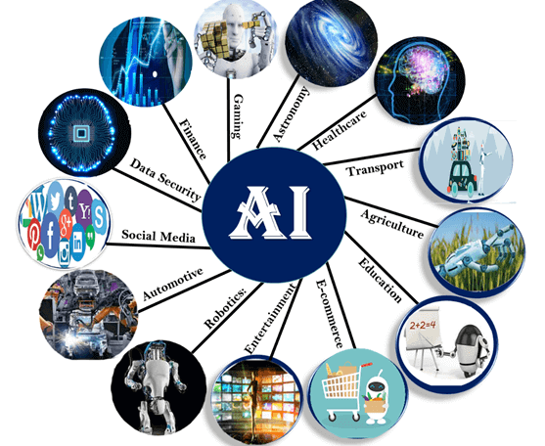
Applications of AI
Artificial Intelligence has various applications
in today's society.
It is becoming essential for today's time because
it can solve complex problems with an efficient
way in multiple industries, such as Healthcare,
entertainment, finance, education, etc.
AI is making our daily life more comfortable
and fast.
Following are some sectors which have
the application of Artificial Intelligence:

Slide 21
Artificial Intelligence has many practical applications across various industries and domains, including:
Healthcare: AI is used for medical diagnosis, drug discovery, and predictive analysis of diseases
Finance: AI helps in credit scoring, fraud detection, and financial forecasting.
Retail: AI is used for product recommendations, price optimization, and supply chain management.
Manufacturing: AI helps in quality control, predictive maintenance, and production optimization
Transportation: AI is used for autonomous vehicles, traffic prediction, and route optimization
Customer service: AI-powered chatbots are used for customer support, answering frequently asked questions, and handling simple requests
Security: AI is used for facial recognition, intrusion detection, and cybersecurity threat analysis
Marketing: AI is used for targeted advertising, customer segmentation, and sentiment analysis.
Education: AI is used for personalized learning, adaptive testing, and intelligent tutoring systems

Slide 22
1. AI in Astronomy
Artificial Intelligence can be very useful to solve complex universe problems. AI technology can be helpful for understanding the universe such as how it works, origin, etc.
2. AI in Healthcare
In the last, five to ten years, AI becoming more advantageous for the healthcare industry and going to have a significant impact on this industry.
Healthcare Industries are applying AI to make a better and faster diagnosis than humans.
AI can help doctors with diagnoses and can inform when patients are worsening so that medical help can reach to the patient before hospitalization.

Slide 23
3. AI in Gaming
AI can be used for gaming purpose. The AI machines can play strategic games like chess, where the machine needs to think of a large number of possible places.
4. AI in Finance
AI and finance industries are the best matches for each other. The finance industry is implementing automation, chatbot, adaptive intelligence, algorithm trading, and machine learning into financial processes.

Slide 24
5. AI in Data Security
The security of data is crucial for every company and cyber-attacks are growing very rapidly in the digital world.
AI can be used to make your data more safe and secure.
some examples such as AEG bot, AI2 Platform, are used to determine software bug and cyber-attacks in a better way.
6. AI in Social Media
Social Media sites such as Facebook, Twitter, and Snapchat contain billions of user profiles, which need to be stored and managed in a very efficient way.
AI can organize and manage massive amounts of data.
AI can analyze lots of data to identify the latest trends, hashtag, and requirement of different users.

Slide 25
7. AI in Travel & Transport
AI is becoming highly demanding for travel industries.
AI is capable of doing various travel related works such as from making travel arrangement to suggesting the hotels, flights, and best routes to the customers.
Travel industries are using AI-powered chatbots which can make human-like interaction with customers for better and fast response.
8. AI in Automotive Industry
Some Automotive industries are using AI to provide virtual assistant to their user for better performance.
Such as Tesla has introduced TeslaBot, an intelligent virtual assistant.
Various Industries are currently working for developing self-driven cars which can make your journey more safe and secure.

Slide 26
9. AI in Robotics:
Artificial Intelligence has a remarkable role in Robotics.
Usually, general robots are programmed such that they can perform some repetitive task, but with the help of AI, we can create intelligent robots which can perform tasks with their own experiences without pre-programmed.
Humanoid Robots are best examples for AI in robotics, recently the intelligent Humanoid robot named as Erica and Sophia has been developed which can talk and behave like humans.
10. AI in Entertainment
We are currently using some AI based applications in our daily life with some entertainment services such as Netflix or Amazon.
With the help of ML/AI algorithms, these services show the recommendations for programs or shows.

Slide 27
11. AI in Agriculture
Agriculture is an area which requires various resources, labor, money, and time for best result.
Now a day's agriculture is becoming digital, and AI is emerging in this field. Agriculture is applying AI as agriculture robotics, solid and crop monitoring, predictive analysis.
AI in agriculture can be very helpful for farmers.
12. AI in E-commerce
AI is providing a competitive edge to the e-commerce industry, and it is becoming more demanding in the e-commerce business.
AI is helping shoppers to discover associated products with recommended size, color, or even brand.

Slide 28
13. AI in education:
AI can automate grading so that the tutor can have more time to teach.
AI chatbot can communicate with students as a teaching assistant.
AI in the future can be work as a personal virtual tutor for students, which will be accessible easily at any time and any place.

Slide 29
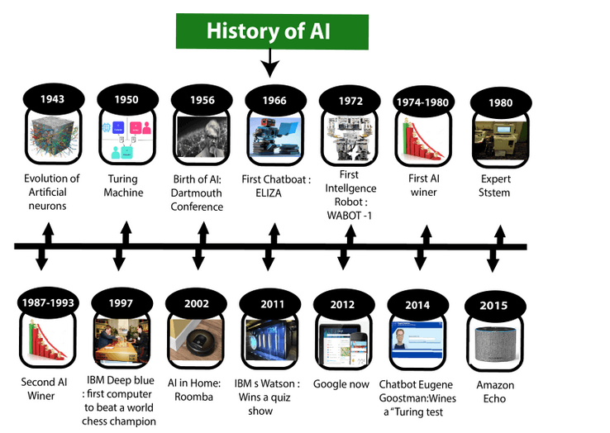

Slide 30
Maturation of Artificial Intelligence (1943-1952)
Year 1943: The first work which is now recognized as AI was done by Warren McCulloch and Walter pits in 1943. They proposed a model of artificial neurons.
Year 1949: Donald Hebb demonstrated an updating rule for modifying the connection strength between neurons. His rule is now called Hebbian learning.
Year 1950: The Alan Turing who was an English mathematician and pioneered Machine learning in 1950. Alan Turing publishes "Computing Machinery and Intelligence" in which he proposed a test. The test can check the machine's ability to exhibit intelligent behavior equivalent to human intelligence, called a Turing test.

Slide 31
The birth of Artificial Intelligence (1952-1956)
Year 1955: An Allen Newell and Herbert A. Simon created the "first artificial intelligence program"Which was named as "Logic Theorist".
This program had proved 38 of 52 Mathematics theorems, and find new and more elegant proofs for some theorems.
Year 1956: The word "Artificial Intelligence" first adopted by American Computer scientist John McCarthy at the Dartmouth Conference.
For the first time, AI coined as an academic field.
At that time high-level computer languages such as FORTRAN, LISP, or COBOL were invented. And the enthusiasm for AI was very high at that time.

Slide 32
The golden years-Early enthusiasm (1956-1974)
Year 1966: The researchers emphasized developing algorithms which can solve mathematical problems.
Joseph Weizenbaum created the first chatbot in 1966, which was named as ELIZA.
Year 1972: The first intelligent humanoid robot was built in Japan which was named as WABOT-1.
The first AI winter (1974-1980)
The duration between years 1974 to 1980 was the first AI winter duration.
AI winter refers to the time period where computer scientist dealt with a severe shortage of funding from government for AI researches.
During AI winters, an interest of publicity on artificial intelligence was decreased.

Slide 33
A boom of AI (1980-1987)
Year 1980: After AI winter duration, AI came back with "Expert System". Expert systems were programmed that emulate the decision-making ability of a human expert.
In the Year 1980, the first national conference of the American Association of Artificial Intelligence was held at Stanford University.
The second AI winter (1987-1993)
The duration between the years 1987 to 1993 was the second AI Winter duration.
Again Investors and government stopped in funding for AI research as due to high cost but not efficient result. The expert system such as XCON was very cost effective.

Slide 34
The emergence of intelligent agents (1993-2011)
Year 1997: In the year 1997, IBM Deep Blue beats world chess champion, Gary Kasparov, and became the first computer to beat a world chess champion.
Year 2002: for the first time, AI entered the home in the form of Roomba, a vacuum cleaner.
Year 2006: AI came in the Business world till the year 2006. Companies like Facebook, Twitter, and Netflix also started using AI.

Slide 35
Deep learning, big data and artificial general intelligence (2011-present)
Year 2011: In the year 2011, IBM's Watson won jeopardy, a quiz show, where it had to solve the complex questions as well as riddles.
Watson had proved that it could understand natural language and can solve tricky questions quickly.
Year 2012: Google has launched an Android app feature "Google now", which was able to provide information to the user as a prediction.
Year 2014: In the year 2014, Chatbot "Eugene Goostman" won a competition in the infamous "Turing test."
Year 2018: The "Project Debater" from IBM debated on complex topics with two master debaters and also performed extremely well.
Google has demonstrated an AI program "Duplex" which was a virtual assistant and which had taken hairdresser appointment on call, and lady on other side didn't notice that she was talking with the machine.

Slide 36
Now AI has developed to a remarkable level.
The concept of Deep learning, big data, and data science are now trending like a boom. Nowadays companies like Google, Facebook, IBM, and Amazon are working with AI and creating amazing devices.
The future of Artificial Intelligence is inspiring and will come with high intelligence.

